Slide 1

Predicting Loan Defaulters for
ABC Bank
Team 1
Ajith Hegde
Rahul Chinthala
Uday M Hiremath
Yichen Ni
Zhuoyang Wu
In partial fulfillment for MG-GY 8413 - Business Analytics course taught by Prof. J C Bonilla

Slide 2
Project Overview
01
02
03
04
05
06
BUSINESS PROBLEM
DATA REVIEW & FEATURE ENGINEERING
MODEL TRAINING
MODEL SELECTION & FEATURE OF IMPORTANCE
MODELLING & PREDICTIONS
BUSINESS IMPLICATIONS & RECOMMENDATIONS

Slide 3

Problem Analysis
The subprime mortgage crisis in 2008 plunged the United States and even the entire world into a serious financial crisis
Before deciding whether to issue the loan or not, understanding a borrower’s loan repayment ability is critical
Therefore analyzing one’s comprehensive background and historical behaviors would be beneficial to help weed out defaulters

Slide 4
A Glance of the Data
HomeCredit_columns_description.csv
application_train.csv
application_to_score.csv
submission.csv
previous_application.csv*
credit_card_balance.csv*

Slide 5

Data Overview
Understanding the wireframe of the given dataset and its metadata files
Plotting Heatmaps and conducting EDA using summary statistics commands on various columns which had heavy presence of Data
This helped us understand the columns that are more important; that have outliers and missing data entries

Slide 6

Data Cleaning
Dropped 3 Columns: WALLSMATERIAL_MODE, FONDKAPREMONT_MODE, HOUSETYPE_MODE
Data type Conversions: Yes or No -> int type; create factors, days type
Days: Converted all days from -ve -> +ve

Slide 7

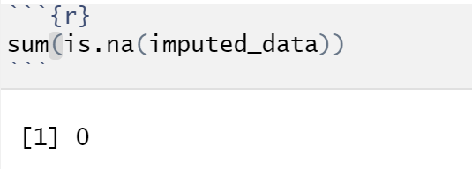
Data Enhancement & Imputation
Used Existing Columns to fill missing categorical Data
Ex: No Property owned -> No BasementAreaMedian
Used assumptions to fill the dataset. Ex: Credit Checks : NA -> 0
Performed imputation with median method to handle the missing numerical values
Created Dummy Variables

Slide 8
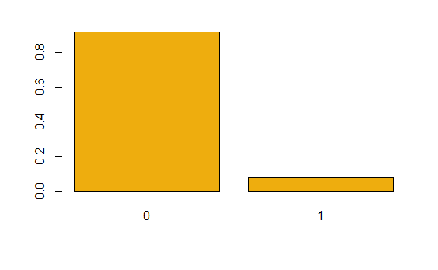
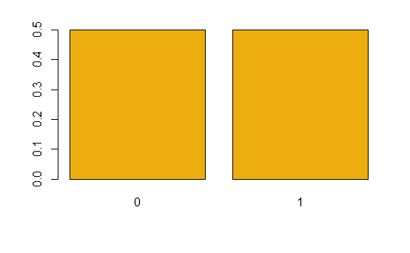
Balancing Training Data
ROSE method
Used combo of both Over and Under Sampling
Before
After

Slide 9

Model Training
Used Balanced Train Data
FitControl method = none/repeatedcv
Performed RF using Randomforest, gbm & then Naive Bayes

Slide 10

Comparing Models
Though RF had the best accuracy, due to technical difficulties, we used gbm for final prediction
 | Accuracy | Precision | Recall | F-Score | Sensitivity | Specificity
Naive Bayes | 39% | 0.95 | 0.36 | 0.52 | 0.78218 | 0.36625
GBM | 67% | 0.99 | 0.67 | 0.82 | 0.66010 | 0.67087
RF | 91% | 0.92 | 0.98 | 0.92 | 0.10763 | 0.98036

Slide 11

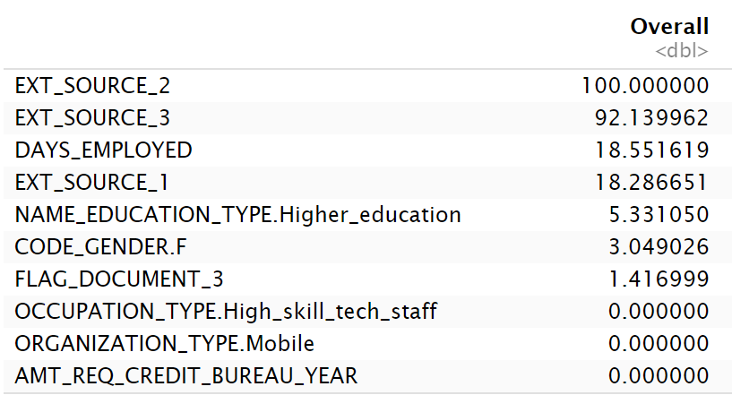
Review of models
GBM model
The displayed model exhibits top 10 attributes order by their importance

Slide 12
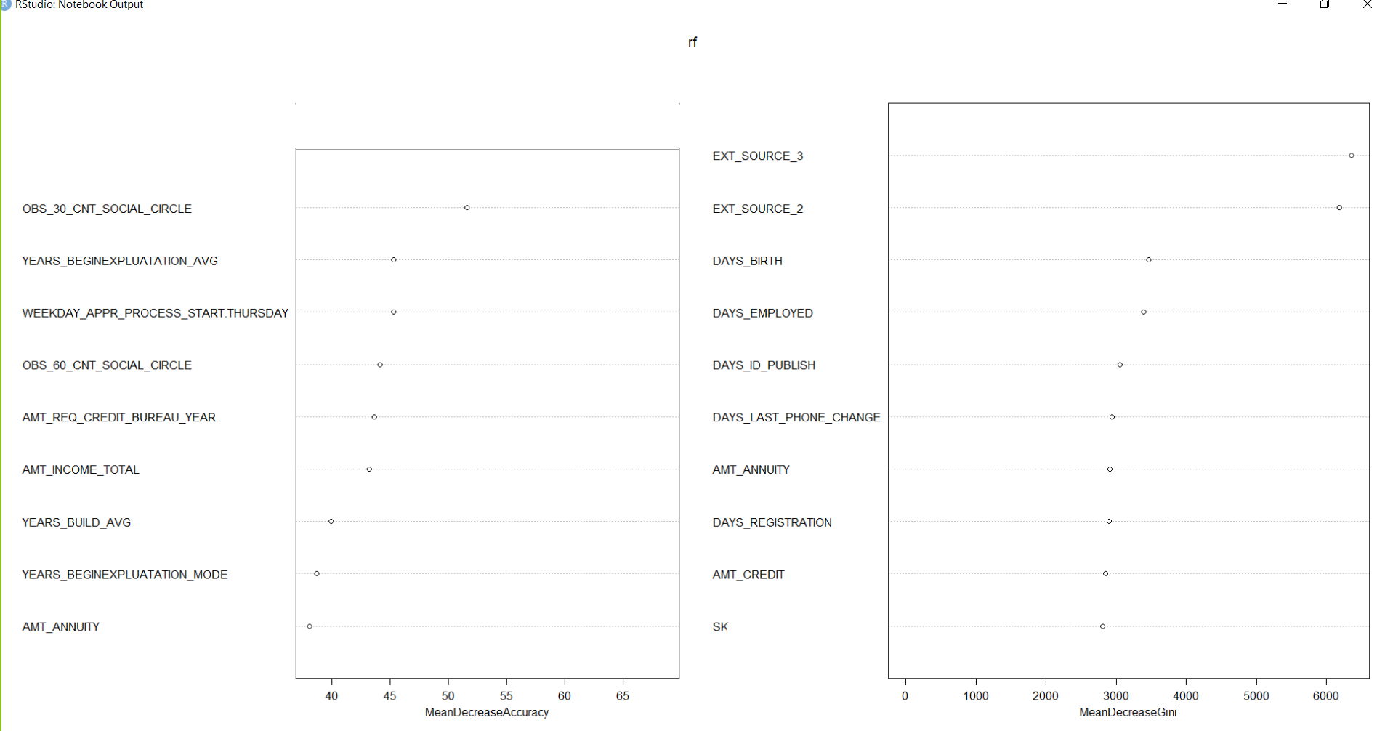
Review of models
RF model
The displayed model exhibits top 10 attributes order by their importance , calculated using Gini Impurity

Slide 13
Scores distributions
68.4%
10520 0’s
4852 1’s
31.6%

Slide 14
Recommendations
B2B Marketing: Employment Stability helps Repayment
Female client is preferred
Age matters
Client with higher Credit Scores (Ext_Sources) preferred
Loan Amount
Beware of Scammers !!
Client with higher Credit Scores (Ext_Sources) don’t cheat
Recent Changes in Applicant’s Identity/Phone/Registration can indicate fraud/defaulters.
(Days_ID_Published, Days_Registration, Days_Last_Phone_Change)

Slide 15
Thank You
Do you have
any questions?

